Slide 1

Tree Alarm
Translated from Russian to English - www.onlinedoctranslator.com
System visualization and control of object states.

Slide 2
Motivation
Most legacy systems remember only the last states of objects, there is no way to view a frame of states in the past. The architecture itself does not provide for tracking moving objects, monitoring is implemented flatly. Those objects have no nesting, so we cannot see the overall picture, only the detailed one. In addition, the client is often forced to receive all the information about the states, without taking into account the operator's area of ​​interest. I'm not even talking about performance. Initially, no one thought about the operation of tens and hundreds of millions of objects in legacy. And in new systems this is often not the case.
Our system (let's call it for now TreeAlarm) takes these shortcomings into account and can complement many legacy systems that are already on the market and operate at large facilities. It is enough to collect their data and store it in its own format. The uniqueness lies in the fact that TreeAlarm represents objects in the form of a treeparent->child_1->child_nand broadcasts the state to the parent. This is a very fast process.
Due to this we can create a structure, say Moscow->Zelenograd Administrative Okrug->Mikron Plant->Server Room->Server 100500->Sensor 777 (alarm)
And the operator is watching Moscow orZelenograd Administrative Okrugcan quickly see the problem as a whole and drill down to the specific meta problem.
Anxiety states are the basic idea for which all this was started. But there are also other states, for example, geographical ones. There is no special uniqueness here, but it is "Must have",. For example, we can record a storm zone as a polygon and save this zone periodically. We can look at this state retrospectively, along with others, and analyze it. Similarly, in logistics, say, the passage of a truck route, we often need archived, not current states, to understand, for example, what led to an event.
The system also has event storage and an event protocol, this is also "Must have".
It is also possible to display "diagrams". Those objects not on a map, but simply as images of, say, rooms. For displaying the logical states of Data Centers, for example.

Slide 3
Not implemented yet
1) Connections between objects. These can be physical connections, such as wires between servers or sockets. Or logical, between any objects.
2) An architectural solution that should simultaneously analyze states and issue alarm events. For example, in Latin America there is a problem: drug cartels carry out drug trafficking in motorcades. Identifying pairs or triplets of cars is a pressing task. To do this, you need to have an archive of states, such as the make and color of the car, and understand that the previous checkpoint had the same set of states and generate an alarm to check the car.

Slide 4
Technologies used
Keycloak – authorization, authentication
React-leaflet, OpenStreetMap –display maps
MongoDB –Database
Docker –containerization
C#, C++ Backendmicroservices
ReactJS Frontend

Slide 5
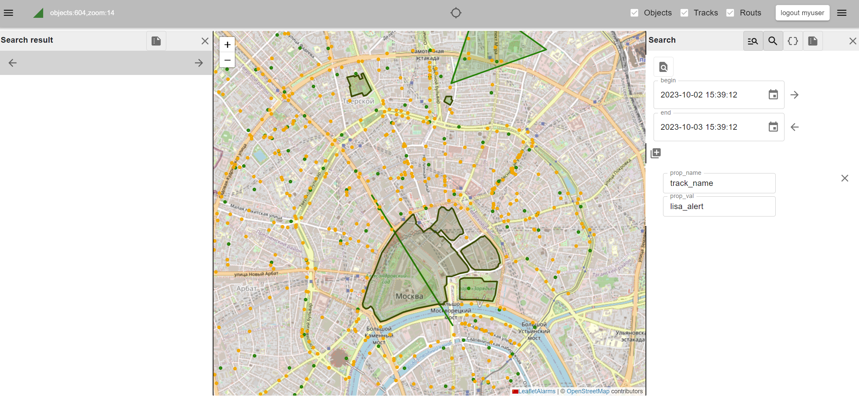
General appearance

Slide 6
The main problem to be solved
The system is primarily aimed at solving the problem of processing the visualization of infinite states/a large number of objects.
There is often a situation where software reaches its scalability limit due to architectural implementation features. For example, it will be difficult for an average computer to process>10 million objects. There are limitations on memory and performance. The solution would be to divide the objects into clusters of 10 million objects and group them within the cluster in the form of a tree.

Slide 7
States
The state of an object is an array of entities that describe the state, such as the state name, its description, color, etc. The state also has an alarm flag.
The alarm flag is passed up the tree, so each parent object has information about the total number of alarms at the levels below, which makes it possible to see how many alarm objects we have at each level and, if necessary, the operator can detail the situation to the lowest level, that is, visually trace the alarm to the tree leaf. For example: Cluster-Country-City-District-Building-room-device.

Slide 8
Tracks
The system can write "tracks" of objects inTime-seriestable, so the user can always find and view archived data.
Tracks are not limited to straight lines. It can also be a change in area, object size, etc.
Data can be filtered by parameters and the area where the object is located (geocoordinates)

Slide 9
Routes
The system has a function for constructing routes. If we have points of appearance of an object on the map, the system can connect using possible routes depending on the type of object (pedestrian, car, cyclistetc.).

Slide 10
Subscribe to events
Possibility to subscribe to system events from other systems. For example, you can receive events on objects of a given geographic region, filtered by parameters.
The system uses the “Publisher-Subscriber template” (Pub-sub pattern)for interaction between the main modules. This also allows third-party modules to simply connect to the message bus and thus influence the workflow.

Slide 11
Examples of micromodules
Telegram module. Can display the group's location. Useful for search groups, which can monitor the search area and each group member individually in real time.
Display module free parking spaces.

Slide 12
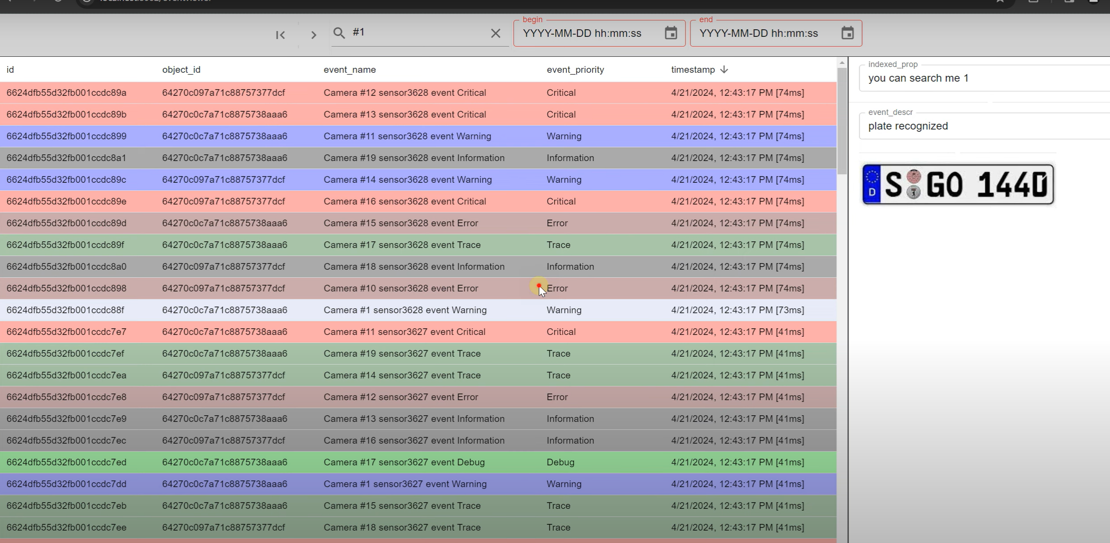
Event Log
A module that provides display of events in the system.

Slide 13
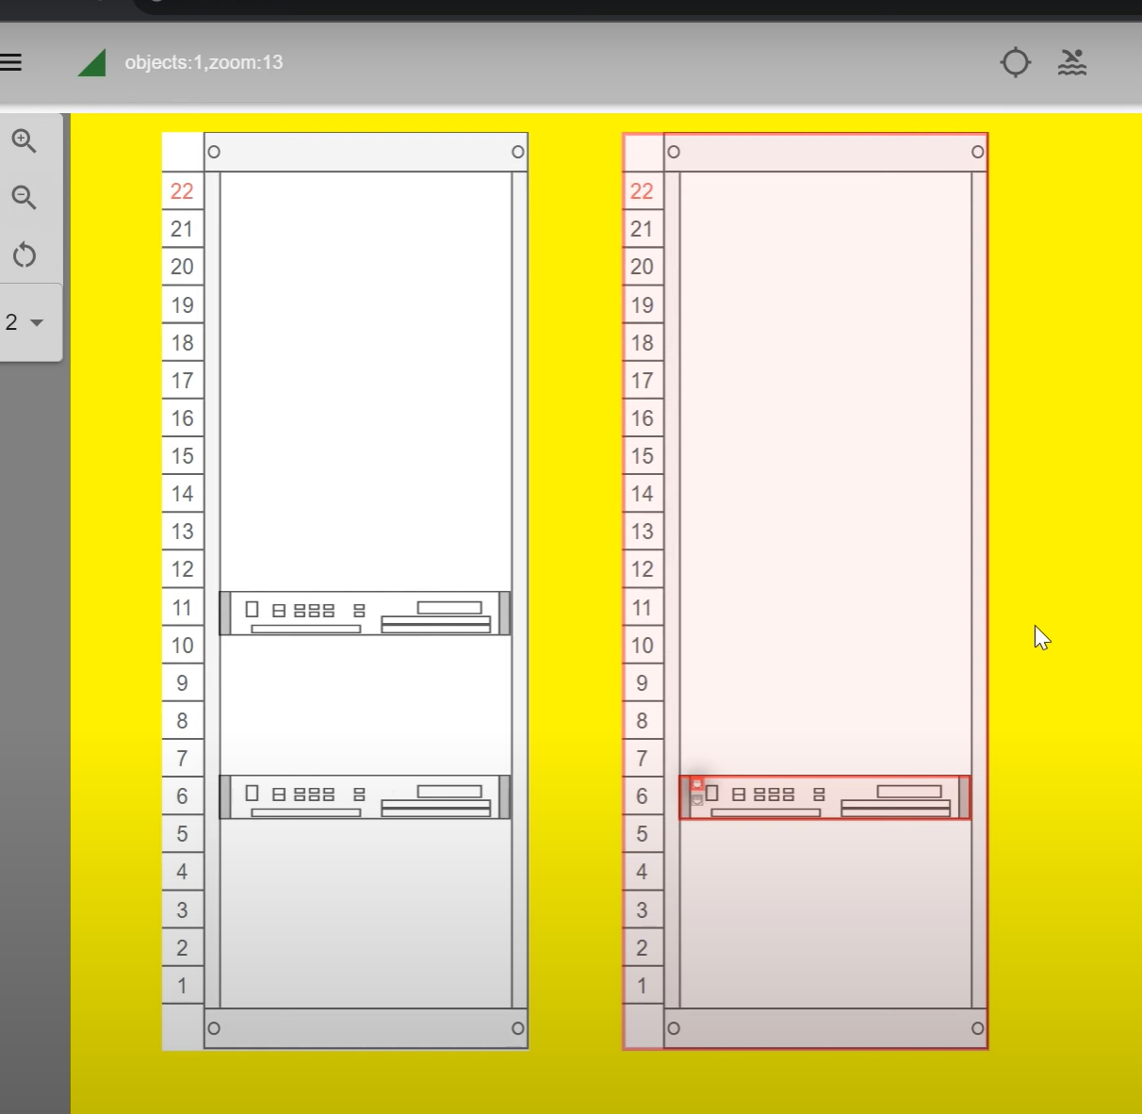
Diagram module
Special module for displaying objects without georeferencing

Slide 14
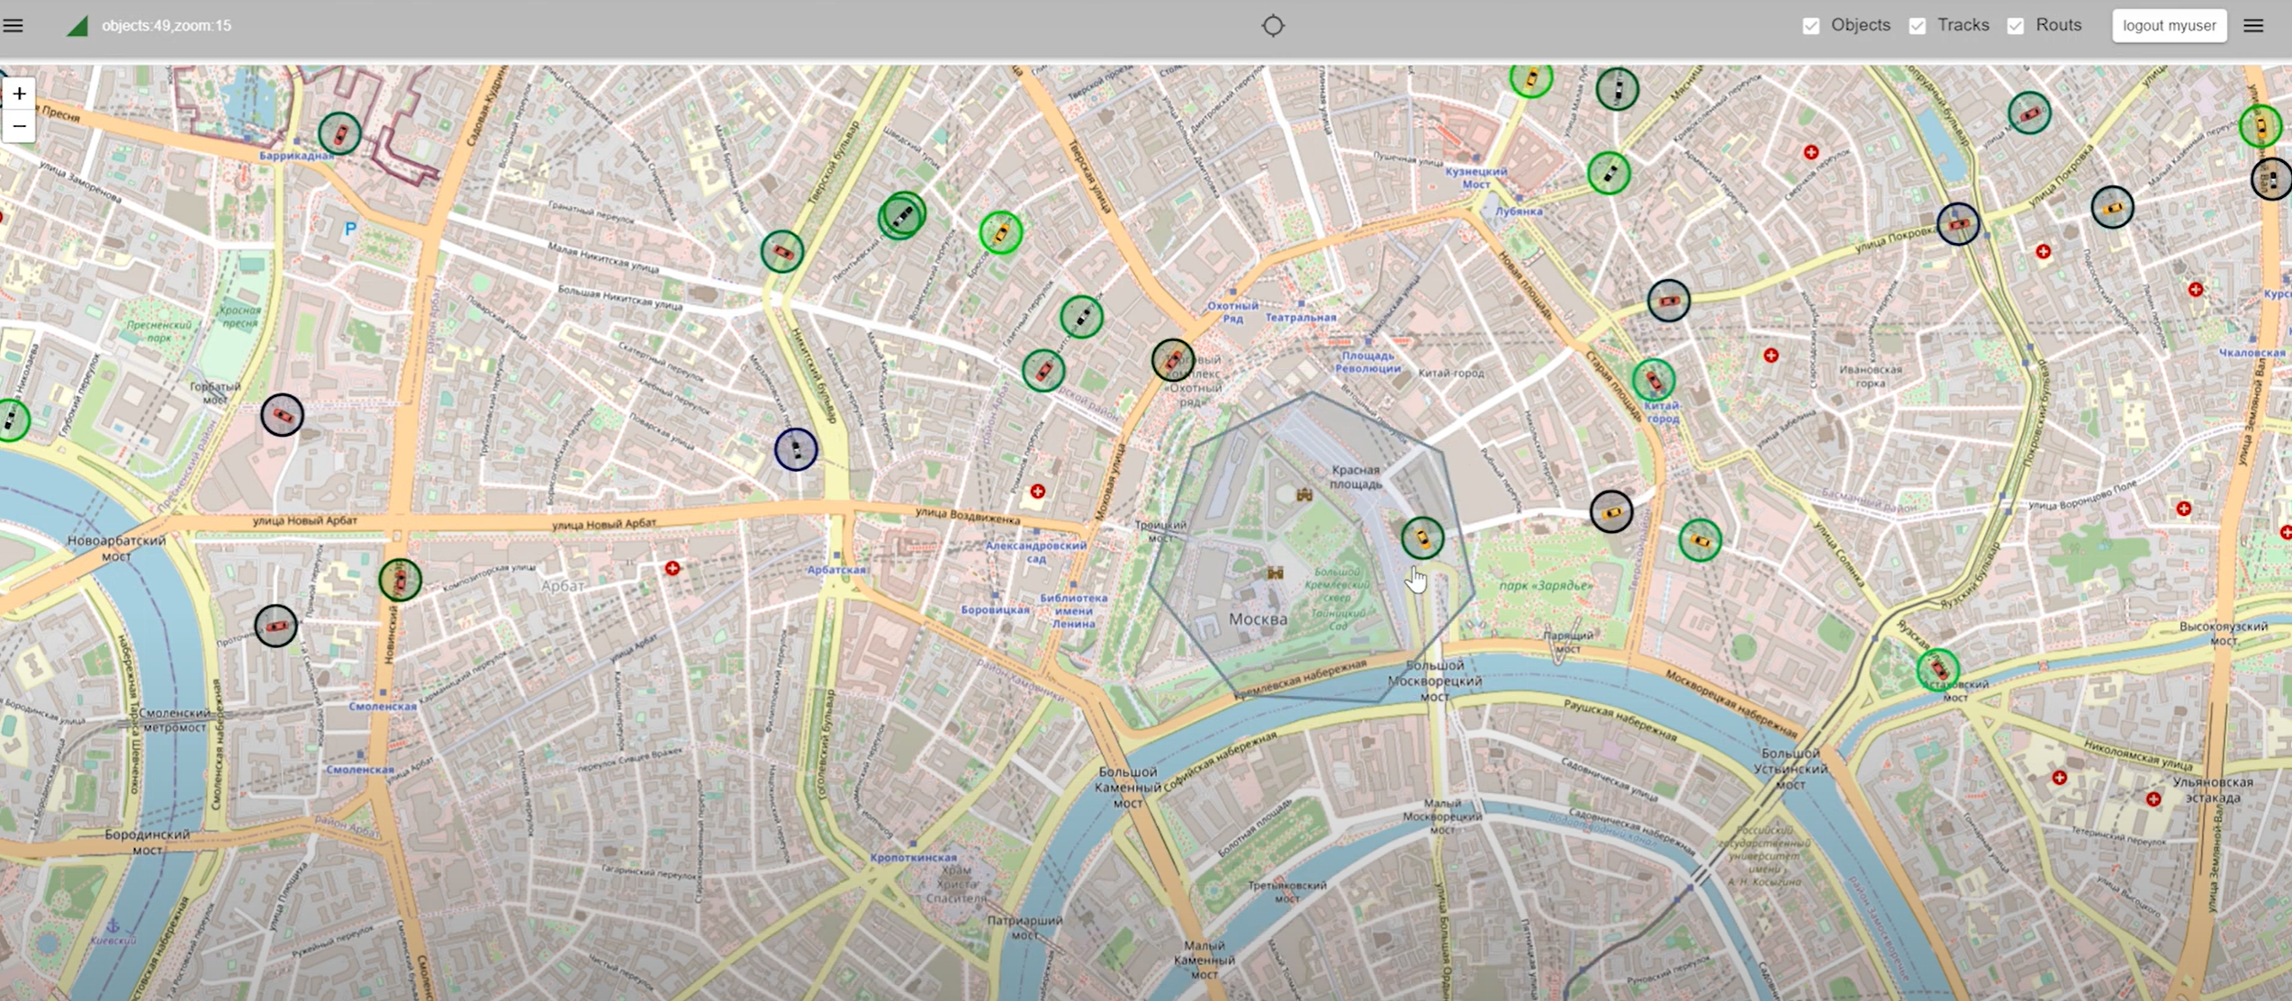
Object display module
Module for displaying general view of states

Slide 15
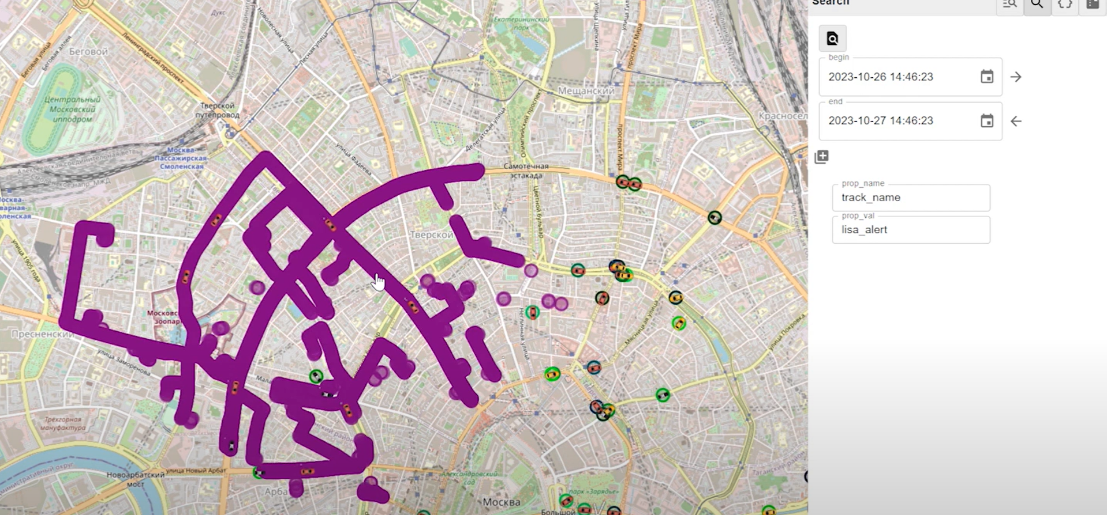
Retrospective module
Search in archive

Slide 16
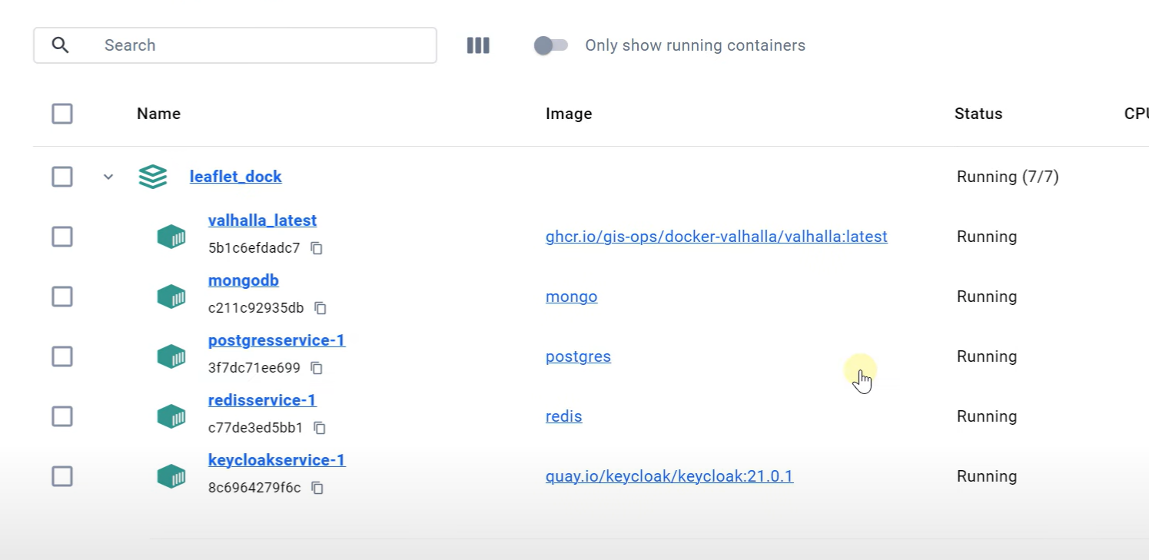
Dependencies in Docker

Slide 17
Results
The system is well suited for integrating several different systems to improve visualization and analysis of large amounts of data.
Place of application: industrial facilities where, due to historical reasons, many different systems have been used that have reached the limit of scalability. At the same time, there is a need to generalize, analyze, visualize and systematize data from all these subsystems, as well as integrate new ones.

